Slide 1
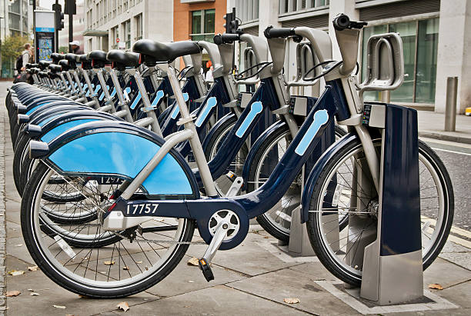
Cyclistic Analysis
Analytical insights of a chicago based bike sharing company

Slide 2

Business Task
How do our casual members differ from our annual ones?
How do we go about converting more casual members into annuals?

Slide 3

Data!
The data is first party sourced data straight from Cyclistic.
The data was then downloaded in accordance to the data license given, uploaded to bigquerry and cleaned.
All personal user information was encrypted and removed from analysis.

Slide 4
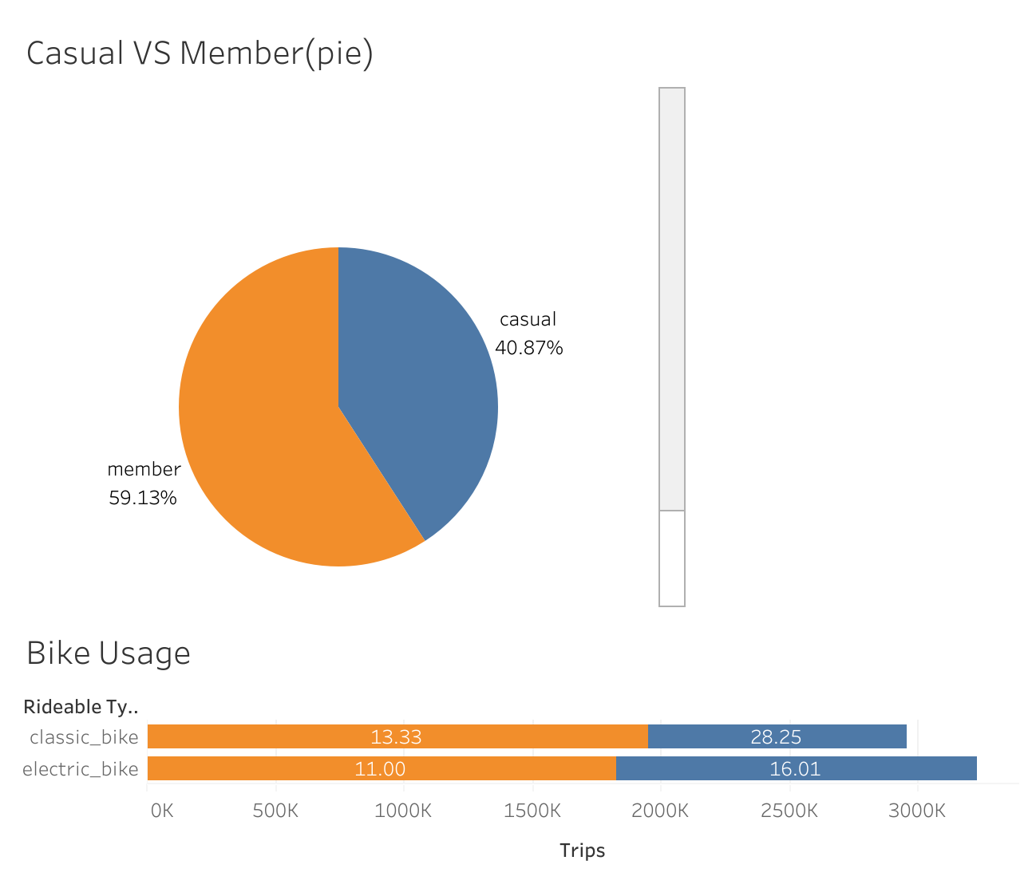
Member Comparison
Casual members represent 40% of users
Electric bikes are used the most but for the shortest average length
Classic bikes are used for longer trips by casual members

Slide 5
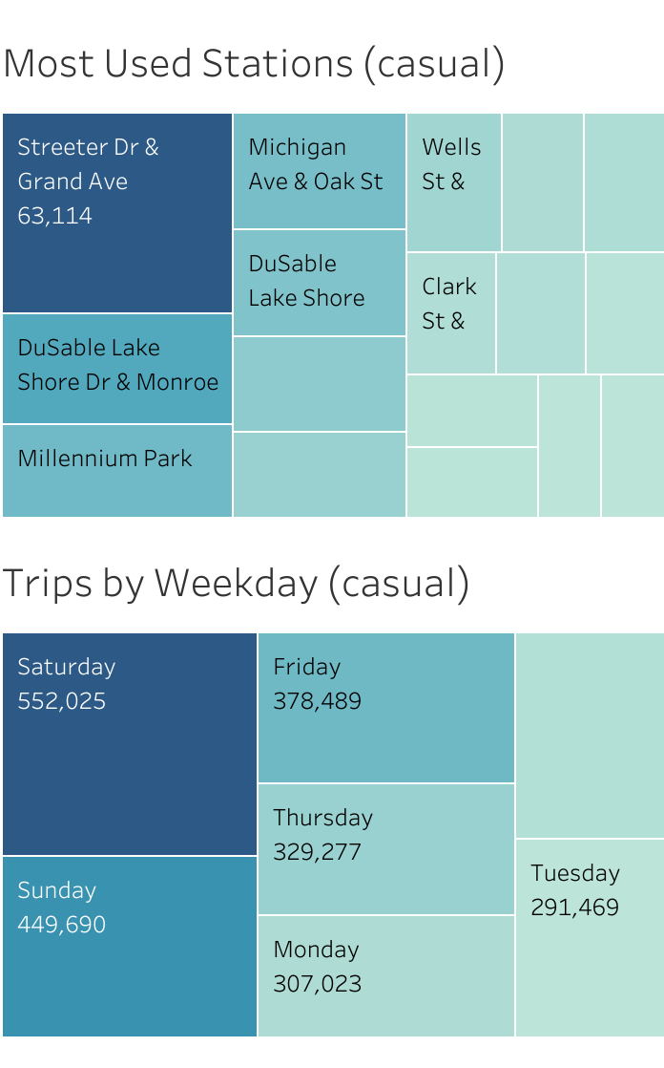
Station and Weekday usage
Casual members use the service most on weekends
They use Streeter Dr & Grande Avenue by far the most
Followed by DuSable Lake Shore and Millennium Park

Slide 6
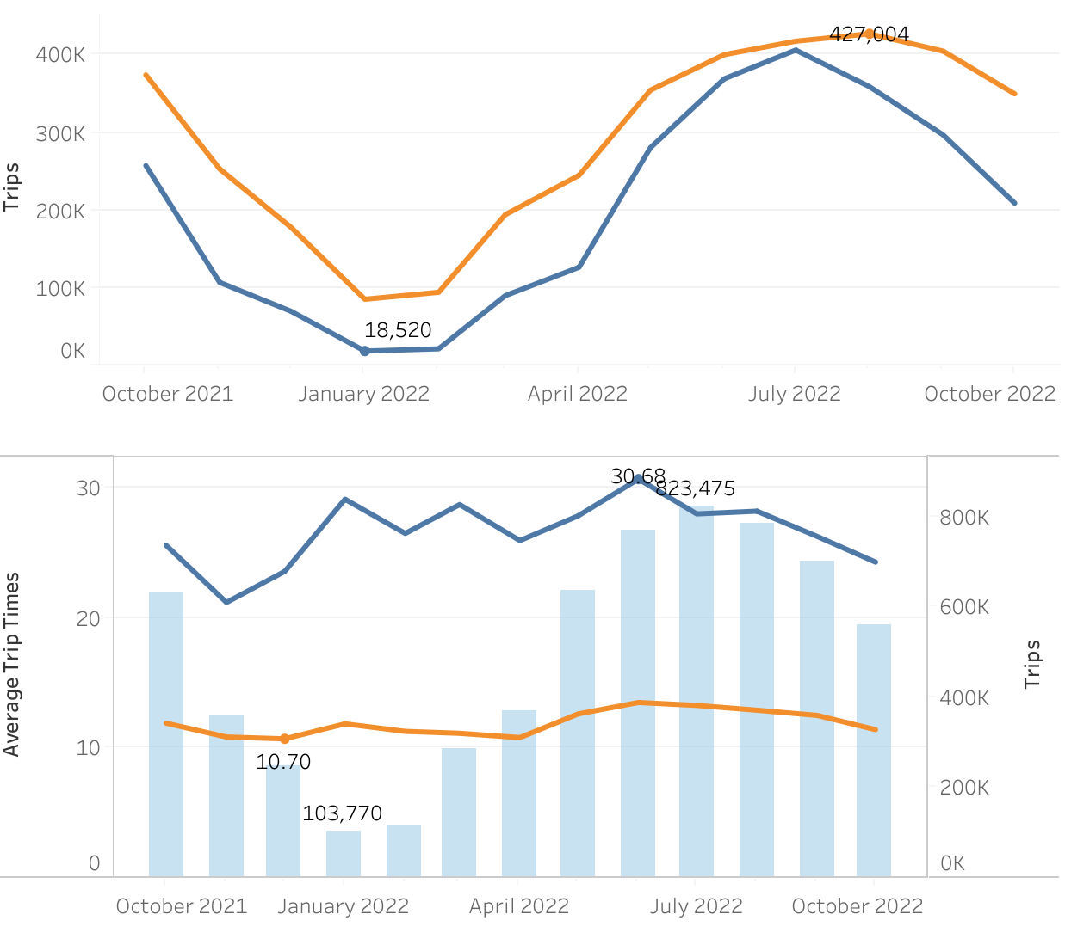
Trips and Trip lengths by Year
Our service is used most in the summer months
Trip lengths are at an all time high during summer months starting around May

Slide 7

Recommendations
To convert more Casual members into annuals I recommend the following actions:
Target ads involving weekend deals in the summer. Start posting in May
Marketing Campaign for annual pricing deals for using electric bikes as well as deals for trips over 20 to 30 minutes
Post advertising around Streeter Drive & Grand avenue station as well as DuSable Lakeshore Drive and Millenium Park stations

